Slide 1
Interactive Kanban Board
Team 1

Slide 2
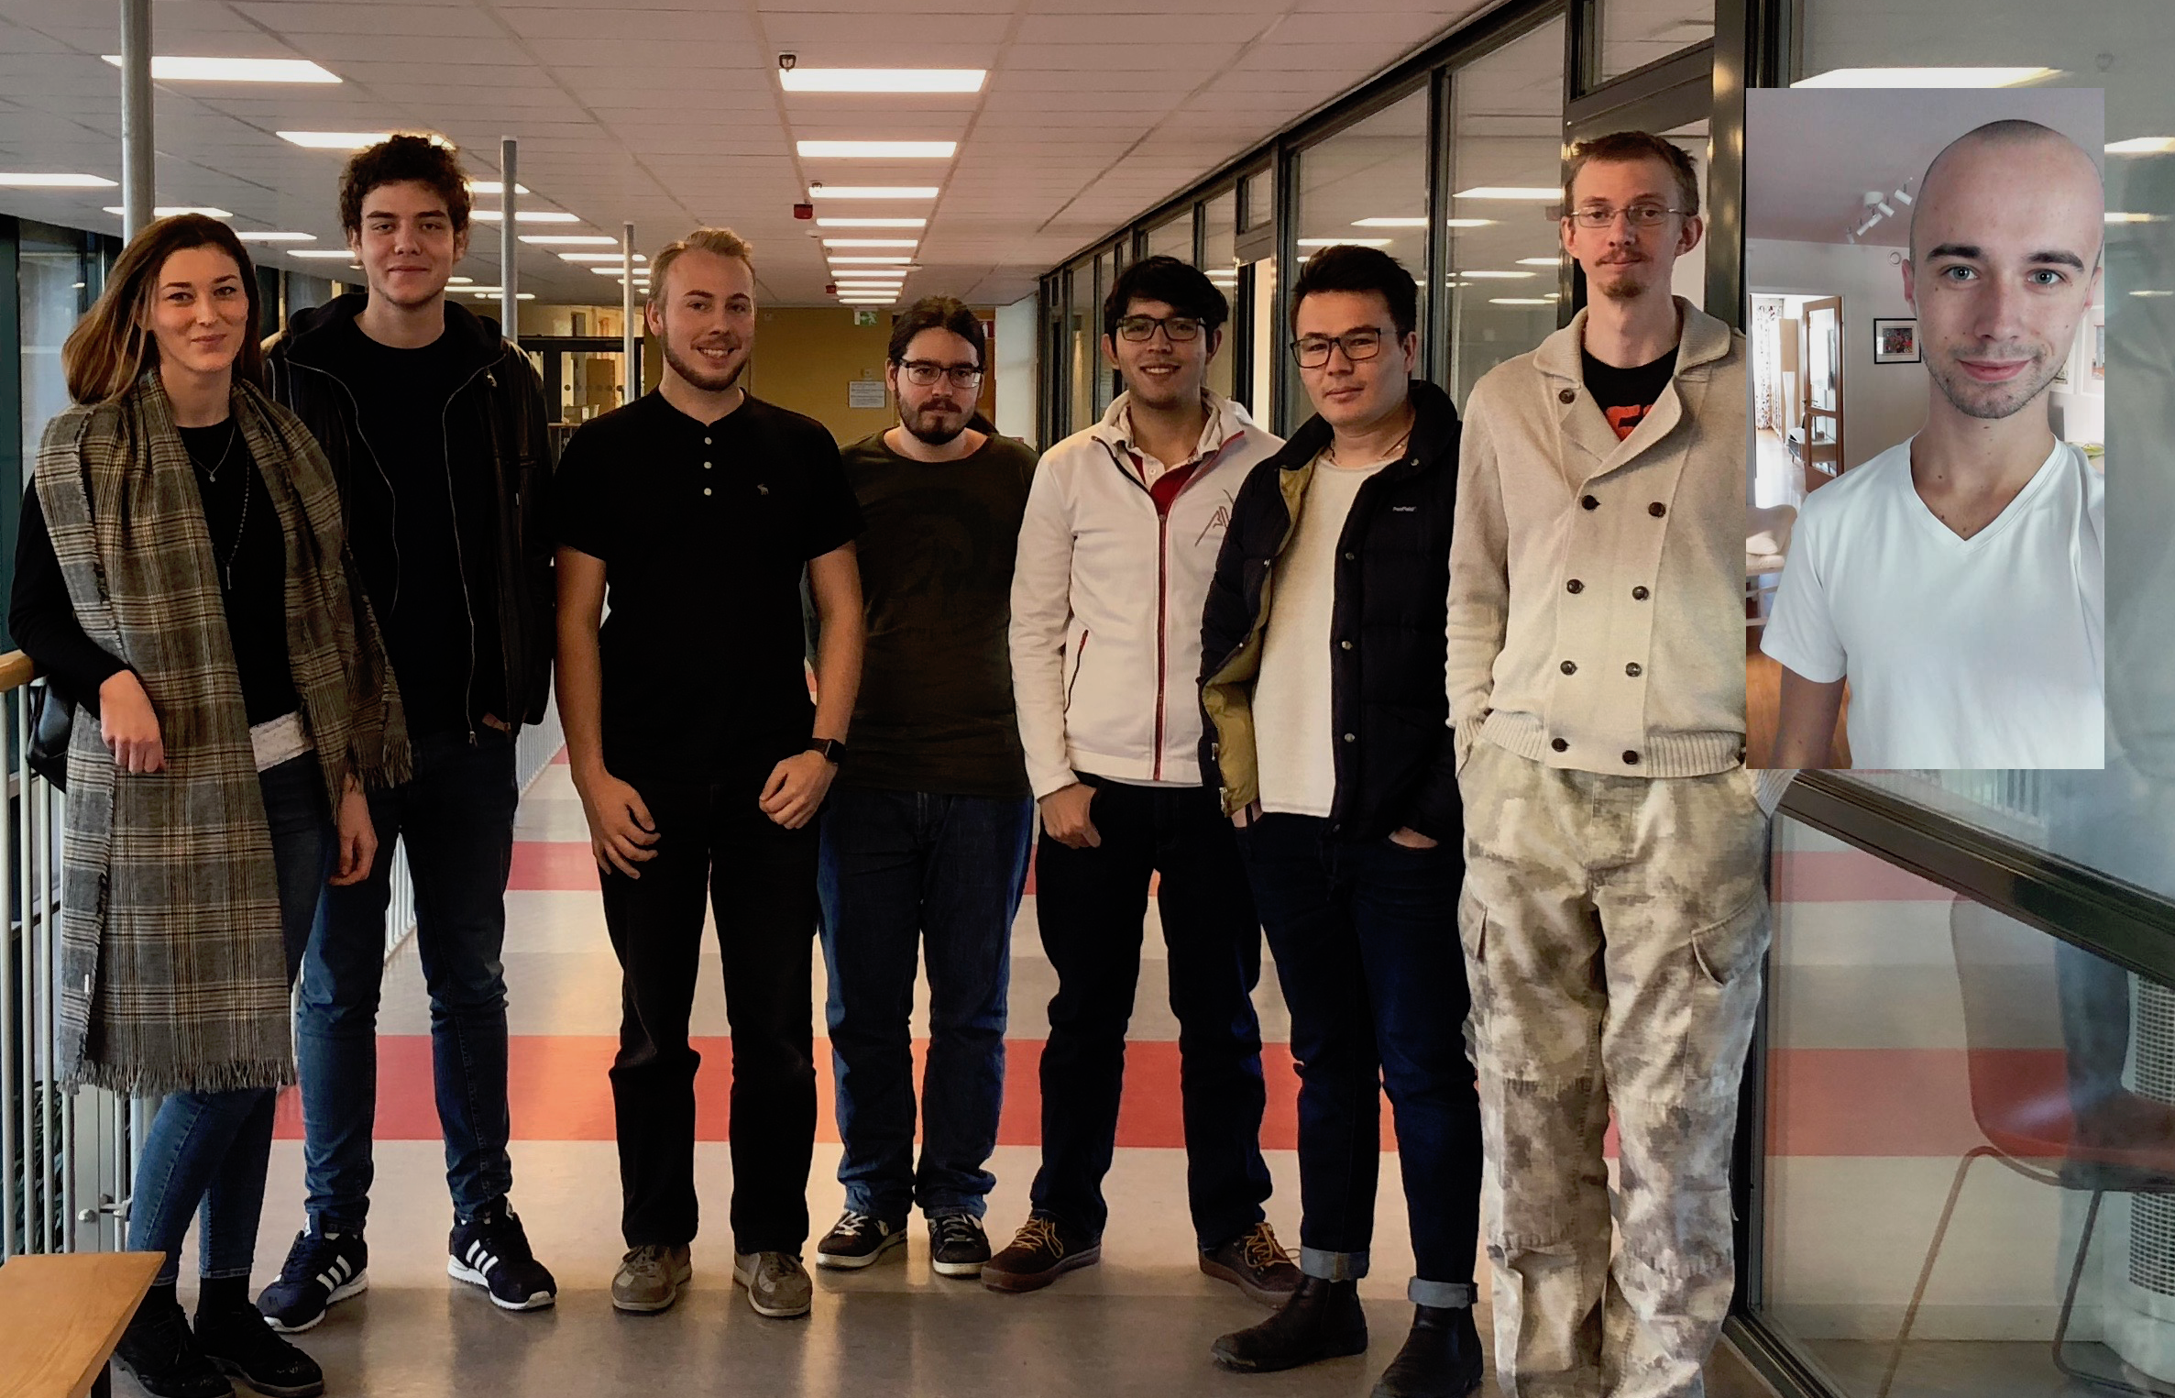
Who are we?
Notes:
DjAna and Amer Exchange students from Bosnia
Taking the Masters programme in Software engineering.
Kevin all the way from Mexico, taking the Bachelors programme in Computer sincence.

Slide 3
Roles and Responsibilities
Project Manager
Client Communication
Configuration Management
Documentation Management
Not set in stone
Notes:
In our group we have some roles
We have:
Common responsibility
This is not set in stone and roles an be added and changed throughout the project.

Slide 4





How will we work
Notes:
GitHub -

Slide 5
Notes:
Slack -
A Messaging platform for teams.
We tried using Facebook Messenger.
Slack allows us to have channels for diferent topics
Works on all platforms and keep our messages searchable.
Lots of integrations.

Slide 6
Notes:
G Suite - Formally known as Google Apps.
We are using Google Docs for collaborative editing.
Everything gets stored in Google Drive.
We have a Google Sheet for time tracking and reporting working hours.
We have a shared google calendar for scheduling meetings.
Our schedules have lots of overlap
But we managed to find 16 hours a week where we are able to work together.
For those times we try to book a group room here in the school.
This seems like a lot of meeting, but it is not just meetings
It’s time when we can work together.
For the first parts of the project, the planning phase and the design phase.
We try to work together as much as possible.
But fridays are used for planning meetings.

Slide 7
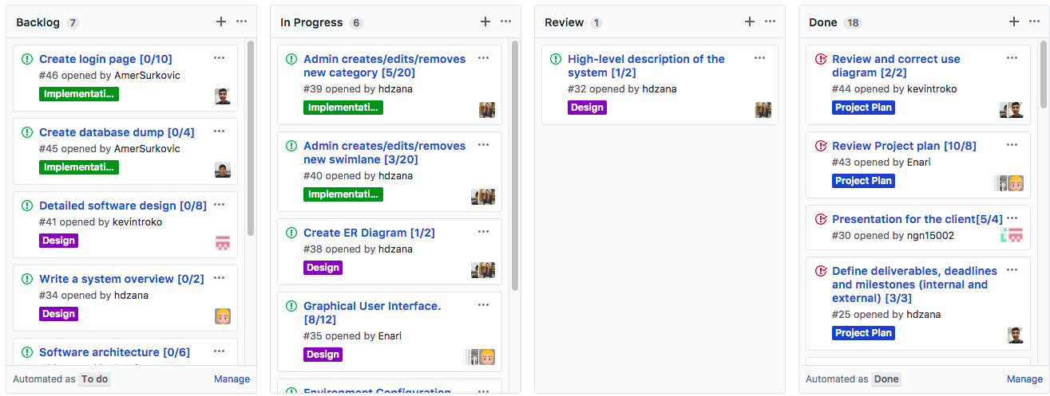
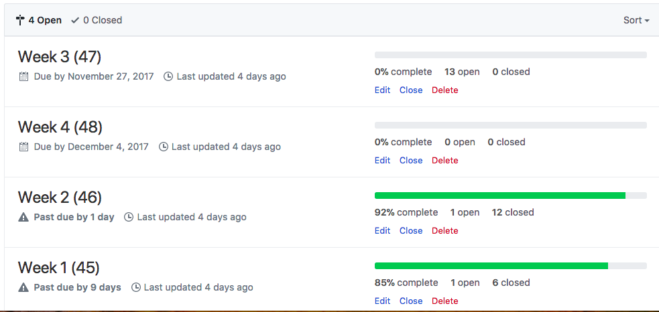
Notes:
I hope that everyone is familiar with git, so i’m not going into details. We use git for code.
We are going to use GitHub, not only for our repo, but for project orginisation as well.
We decided not to use trello, instead we are using github projects.
It allows us to show our issues in a Kanban board.
In our kanban board we have a column for review. We decided that we are going to review both documents and code as a way of Quality assurance
GitHub also allows us to devide our issues into milestones. We have a milestone for each week, so we can easly see what have and should be done each week.
So, that’s it for the tools we are using. Jawid!

Slide 8
Who is our client?
ABB Ports
Application lifecycle management software called TeamForge
But what is the problem?
Notes:
Our Client: Our client is ABB Port and they are developing automation and electrification for container terminals. Christoffer Holmstedt is the contact person and Team lead for an engineering team at ABB Ports. For their project they are in need of a digital kanban board. They have previously used post-it notes on a Whiteboard, but the high maintenance caused the system to fall apart about a year ago. Team Forge: Now the team at ABB are working with an application lifecycle management software called TeamForge by Collabnet. While TeamForge has its built-in kanban board but it does not fulfill their requirements. The problem: It does not offer them options for custom categories, swimlanes and is not practical to use on daily meetings. The goal with this project is to create a digital Kanban board that use data from TeamForge and visualise it in the Kanban board so that the whole team can track project tasks.

Slide 9
What is the system they want?
Digital kanban board with drag and drop functionality
Different user rules - Administrator (Team lead) - Team member
Local users
Web application
Long story short
Notes:
Our client wants a digital kanban board with drag and drop functionality. They want to use the kanban board for their projects that every team member can have access to it. The kanban board is a good view of what tasks the team lead find to important and should be done by team member.

Slide 10
Client Interaction - Communication methods
Physical meetings
Email
Notes:
Two meetings so far

Slide 11
Client Interaction - Preparation
Examination of our view of the system
Identification of things that are unclear
Define questions
Notes:
Take note of the questions (No need to mention GitHub Wiki)

Slide 12
Client Interaction - Detailed account
First meeting:
Rudimentary requirements and ideas
High-level view of the system
Some specific detailed requirements
Second meeting:
Clarification
Redefinition of requirements
Notes:
School, Project scope

Slide 13
Initial Backlog for User
Description | Priority | Effort
Login and Logout | 1 | 28
See current of Kanban board | 1 | 144
Drag and drop artifacts | 1 | 108
Notes:
The initial backlog for the project is divided in two
The first one is user backlog
In here we put the tasks that we are aiming to done for this project
We add priority and effort to every table
In the user backlog we can see that every task is #1
This is how the system works

Slide 14
Initial Backlog for Admin
Description | Priority | Effort
Create swim lane | 1 | 25
Edit/Delete swim lane | 1 | 10
Create category | 1 | 25
Edit/delete category | 2 | 10
Filter artifacts | 2 | 128
Set limit on number of cards | 3 | 10
Notes:
Kevin
What is swimlane
What is category
For the admin backlog we have more tasks
In the first priority we have the ability to create s

Slide 15
Additional non-functional requirements
Interaction using a touch screen display should be possible
The system must be available during working times of ABB.
Available as a web application for the team at ABB.
Must be capable to run on Linux server.
The Kanban board should be easy to understand and not time consuming.
Notes:
ABB uses this software in team meetings in the morning to see

